Slide 1

HOSPİTAL MANAGEMENT SYSTEM
Eda DANA - 20210808072
Dilan GÜLER - 20210808022
Şehed FATİH - 20200808804
Nour ÇELEBİ - 20210808614
Evin SAVAŞLI – 20210808024

Slide 2
MISSION STATEMENT
«WE CARE ABOUT YOUR PSYCHOLOGİCAL HEALTH AS MUCH AS YOUR PHYSİOLOGİCAL HEALTH»

Slide 3
FACT-FİNDİNG TECHNİQUES
Examining Documentation:
Examining documentation for a hospital management system helped understand how data is structured, where it comes from, how it flows through the system, the standards it follows, and the security measures in place. This insight ensures efficient management, analysis, and protection of healthcare information.

Slide 4
FACT-FİNDİNG TECHNİQUES
Research:
Through systematic inquiry, we investigated the challenges encountered in our online endeavors, conducted comparative analyses of analogous issues addressed by peers, and derived insights from their strategies, enriching our own problem-solving approaches

Slide 5
GENERAL RULES
In our system, a patient cannot schedule appointments with different doctors for the same date and time.
We have other types of people working at the hospital.For example,Nurse..(Customer ‘s request)
Nurses are assigned to doctors
The doctor may ask for a test from patient
The patient can take appointment and removed or update it.(Changes the date )

Slide 6
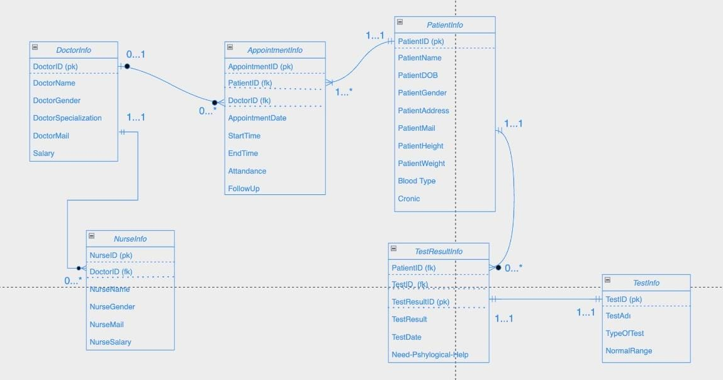
ER DİAGRAM

Slide 7
NORMALİZATİON

Slide 8
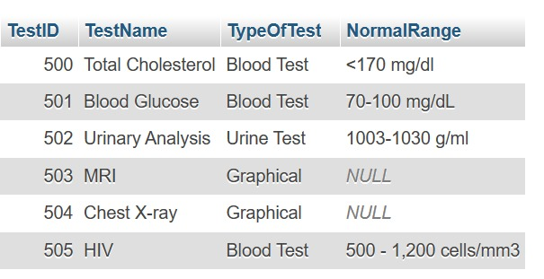

Slide 9
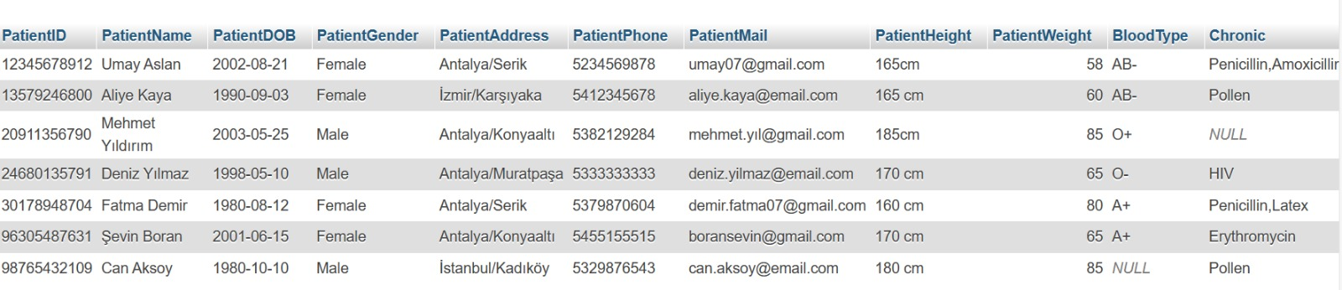

Slide 10
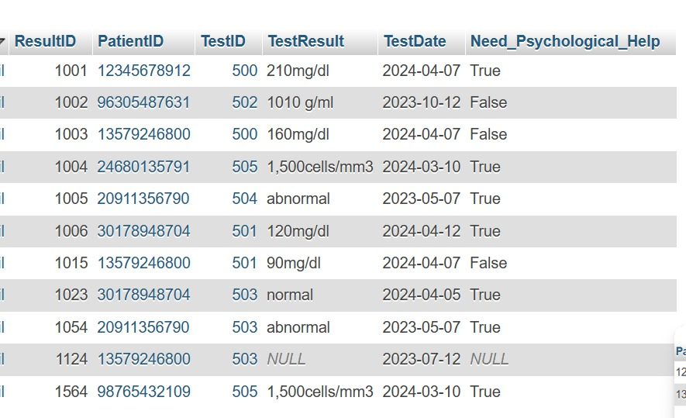

Slide 11
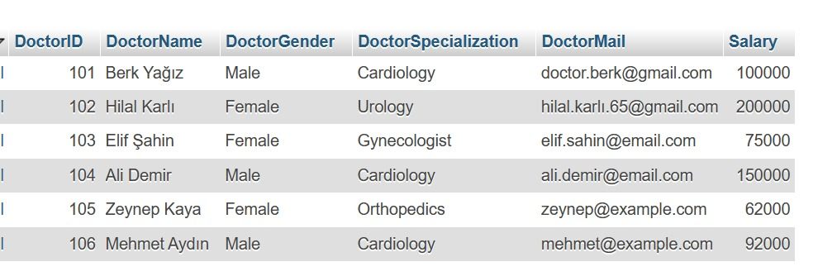

Slide 12
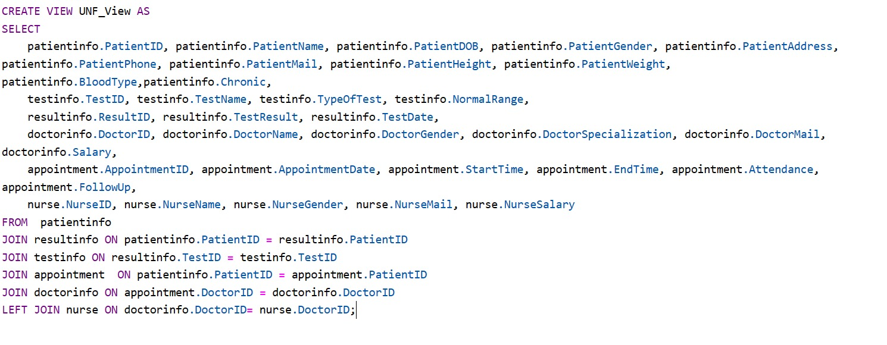

Slide 13
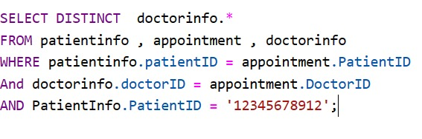
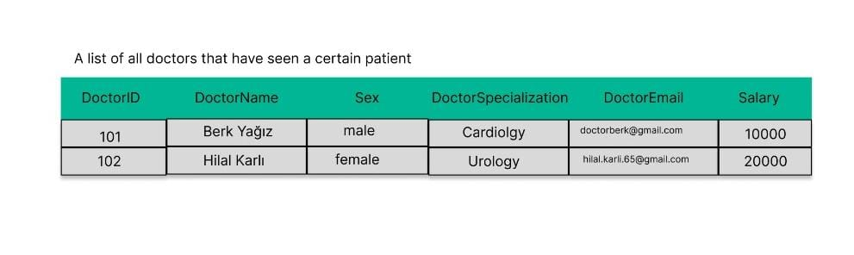
A list of all doctors that have seen a certain patient

Slide 14
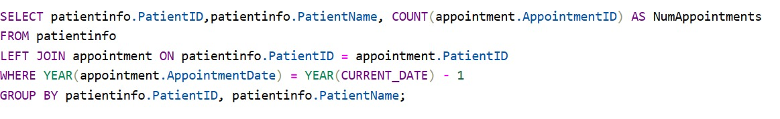
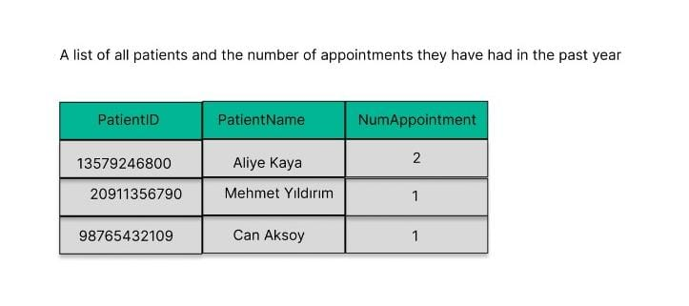
A list of all patient and the number of appointments they have had in the past year

Slide 15
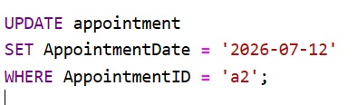
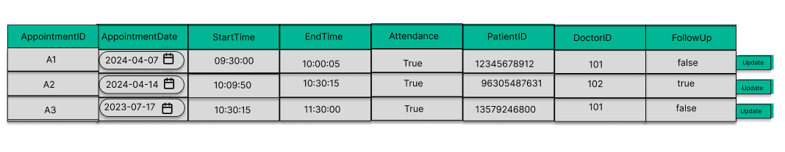
A way to change the date of an appointment

Slide 16
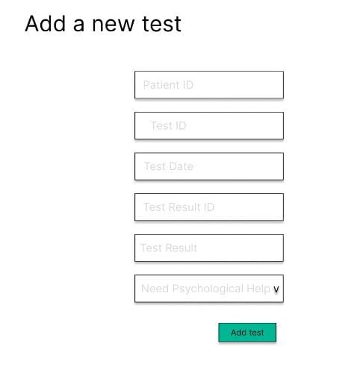
A way to add a test for a patient

Slide 17

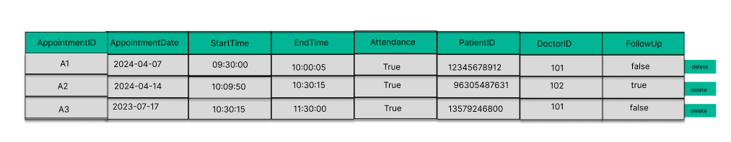
A way to remove an appointment from the system

Slide 18

THANKS FOR LİSTENİNG US…

